Slide 1
Oracle Financials
General Ledger
Toshiba Information Equipment Phils.,Inc.
2023.07.24
Scope of Disclosure | within TIP only
Head of Information Owner Section | TIP

Slide 2
General Ledger
What is GL?
TIP SUBSYTEM FOR GL
GL PROCESS FLOW
COMMON SETUP IN GL

Slide 3
GENERAL LEDGER (GL)
provides a complete record of financial transactions over the life of the company. The ledger holds account information that is needed to prepare financial statements and includes accounts for assets, liabilities, owner’s equity, revenues, and expenses.

Slide 4
GL TIP SUBSYSTEM
HRMS PAYROLL - It involves managing salaries, wages, taxes, and benefits and is crucial for any organization's HR and accounting
WEB PRS LIQUIDATION - Liquidation of request such as reimbursements, cash advance, travels.
IA - TIP INVENTORY ACCOUNTING -
Inventory accounting refers to the process of recording and tracking a company's inventory-related transactions in its financial records.

Slide 5
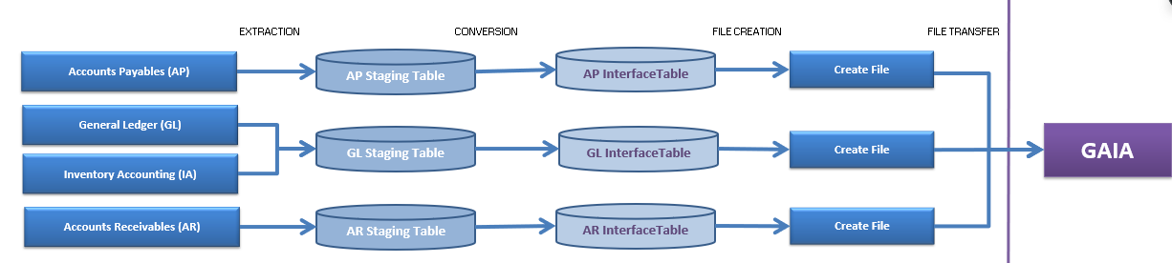
The stages of GAIA Interfacing
Extraction – Extracting Data from GL_Interface and Rcv_Receiving_Sub_Ledger.
Conversion – Conversion of data and error checking
Data file creation – The process of converting data in to .dat file.
Data file transfer – The process of transferring all interfaced data to GAIA.

Slide 6
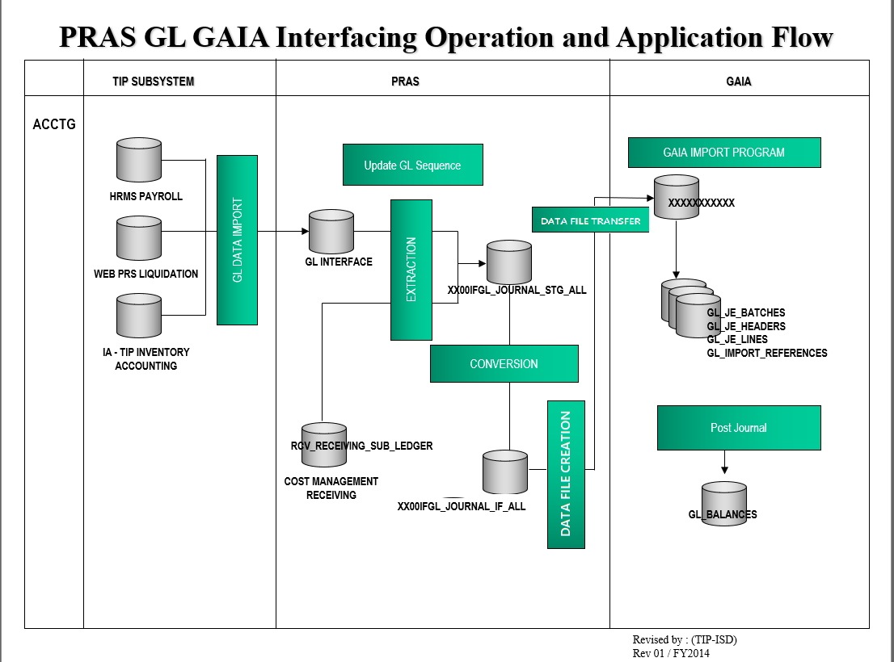

Slide 7
PROGRAM
xx00ifgl_interface_conc_sv_tip.main_extr (EXTRACTION)
xx00ifgl_interface_conc_sv.main_conv (CONVERSION)
xx00ifcmn_func_util_sv.flatfile_creation (DATA FILE CREATION)
XX00IFCMN_FTP (DATA FILE TRANSFER)

Slide 8
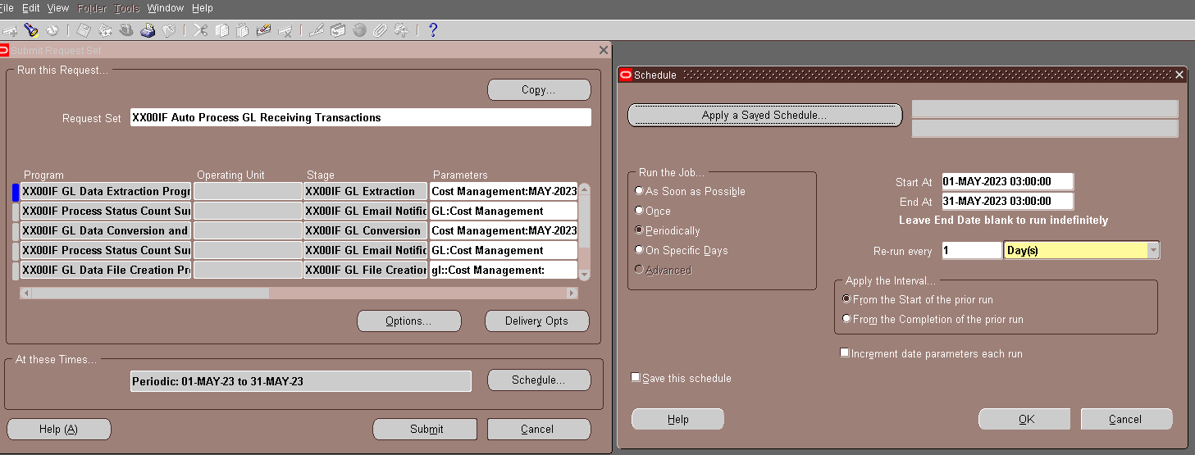

Slide 9
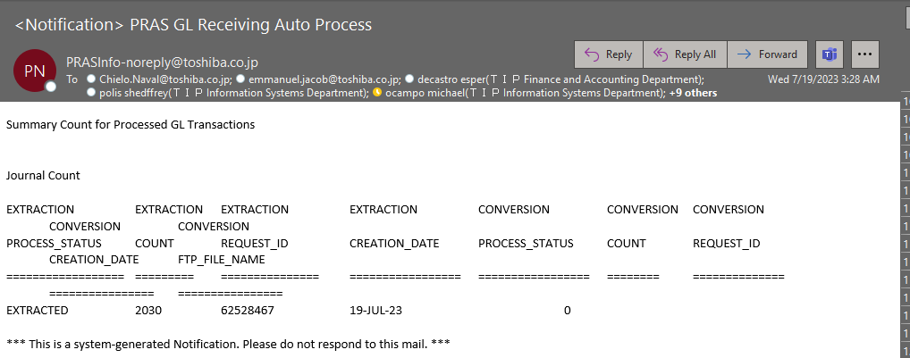

Slide 10
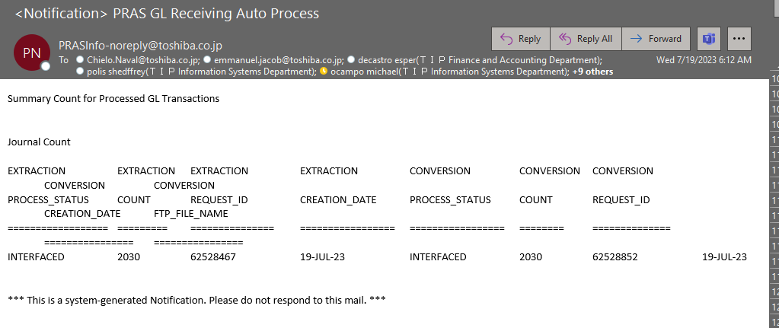

Slide 11
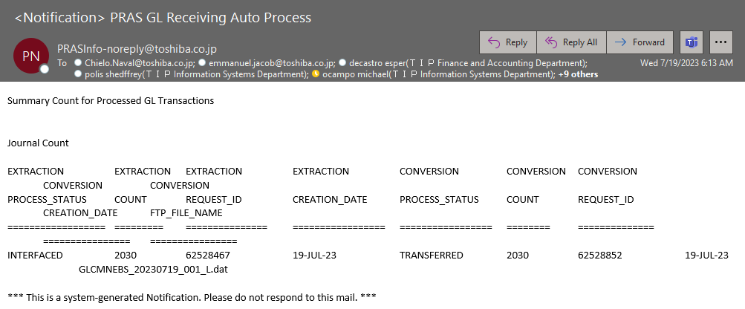

Slide 12
SETUP IN GENERAL LEDGER
FISCAL YEAR
-GL AUTO PROCESS AND SPECIAL BATCHING

Slide 13
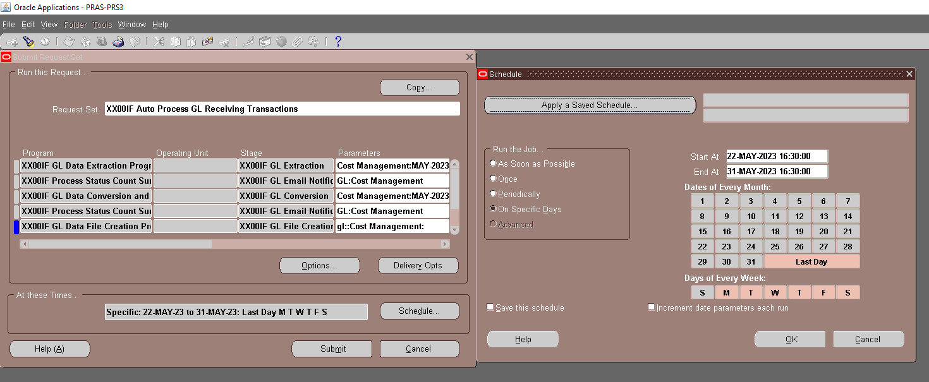

Slide 14
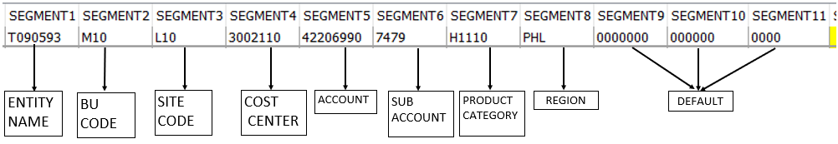
GL CODE COMBINATION OVERVIEW

Slide 15
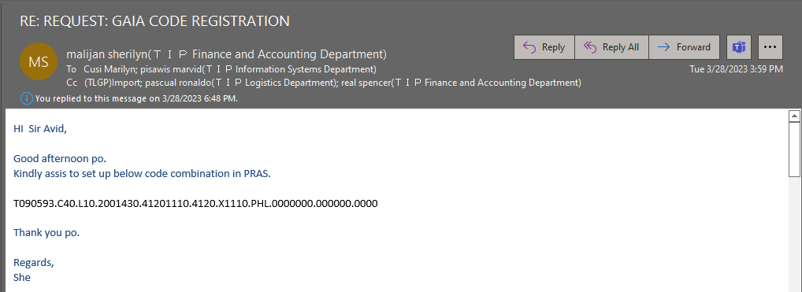
GL CODE COMBINATION SETUP

Slide 16
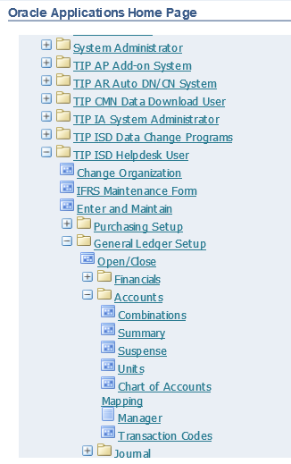
GL CODE COMBINATION SETUP

Slide 17
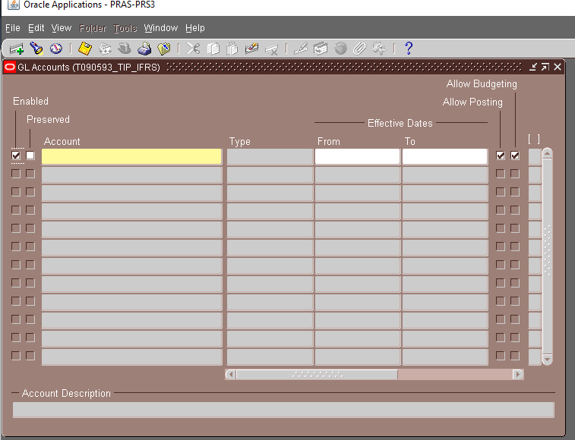

Slide 18
New Cost Center Setup
1. Flexfield setup
System Administrator -> Application -> Flexfield -> Descriptive -> Values
Name: XXGD4_AFF_CENTER
2. Lastpay setup
SELECT *
FROM tip_default_values
WHERE table_name = 'TAPF0002'
AND field_name = 'SECTION'
3. SSS setup
SELECT *
FROM tip_default_values
WHERE table_name = 'TAPF0002'
AND field_name = 'SECT_BU'

Slide 19
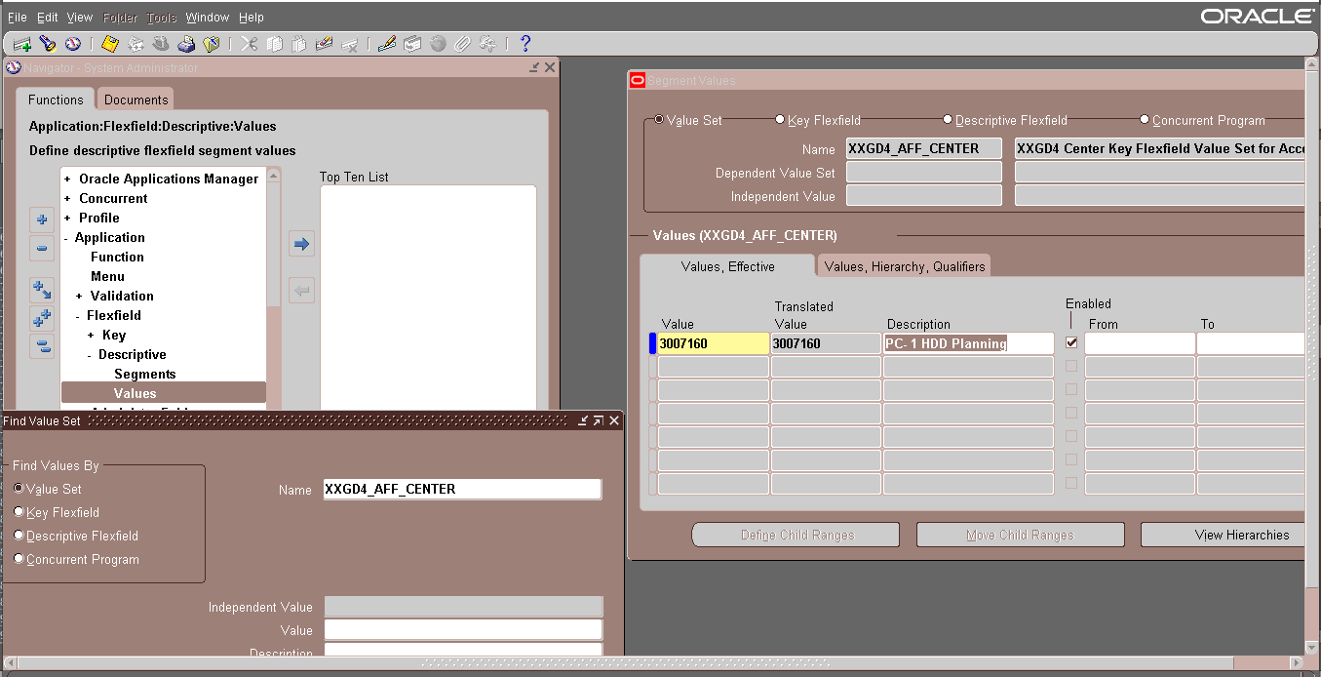
XXGD4

Slide 20
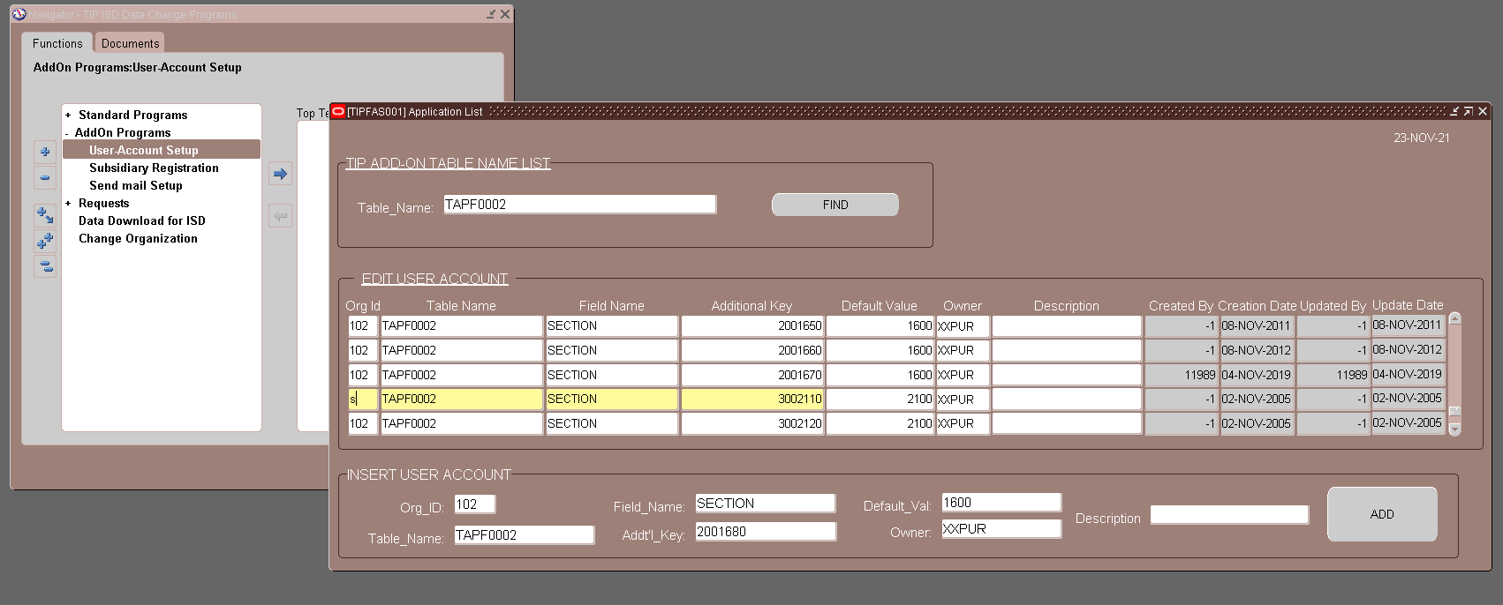
TAPF0002
TIP ISD DATA CHANGE PROGRAMS > ADDON PROGRAMS > USER-ACCOUNT SETUP
DEPARTMENT ID

Slide 21
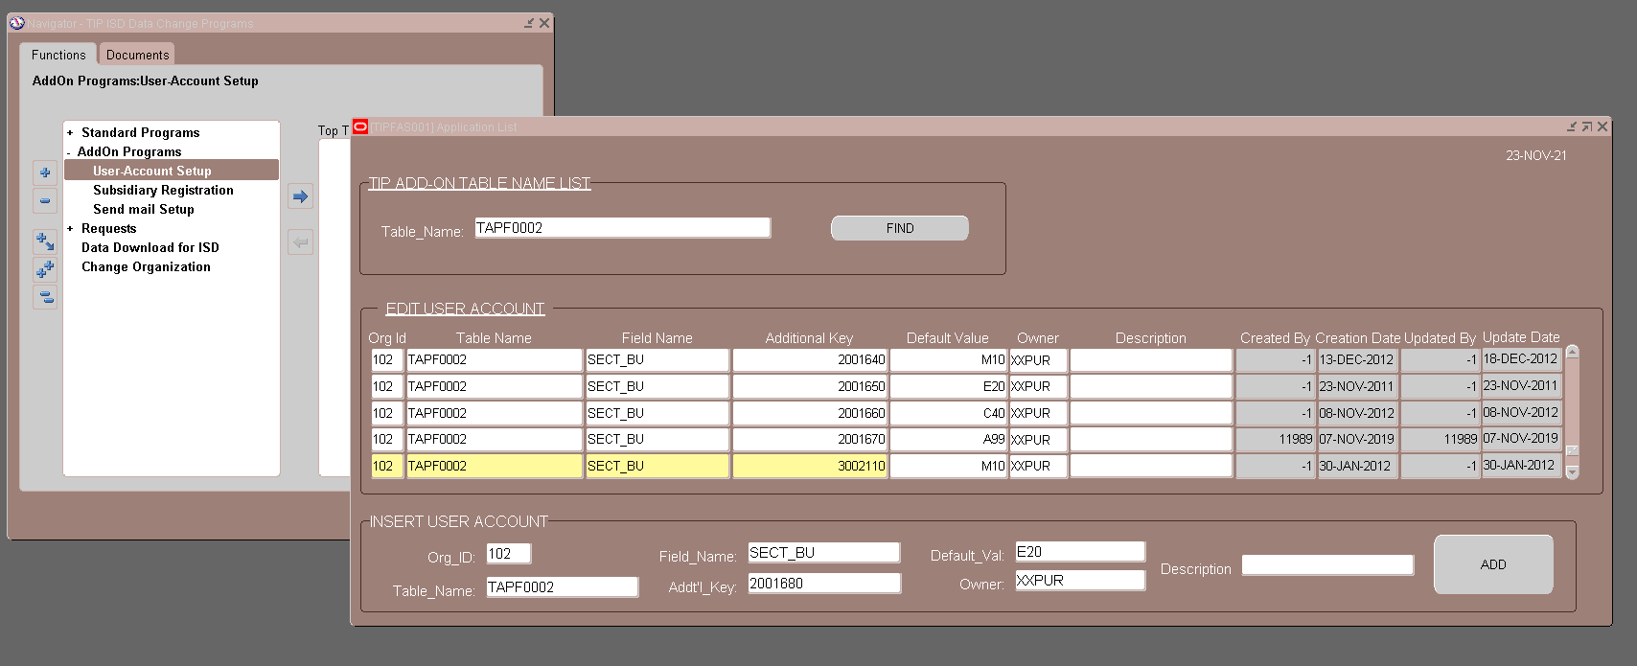
TAPF0002
TIP ISD DATA CHANGE PROGRAMS > ADDON PROGRAMS > USER-ACCOUNT SETUP
SEGMENT2

Slide 22
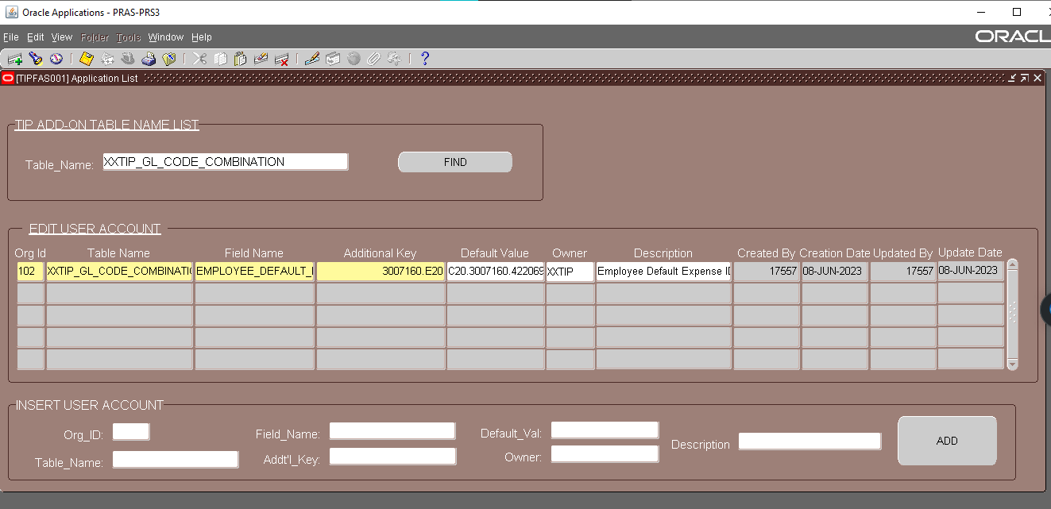
UPDATING THE COST CENTER
TIP ISD DATA CHANGE PROGRAMS > ADDON PROGRAMS > USER-ACCOUNT SETUP

Slide 23
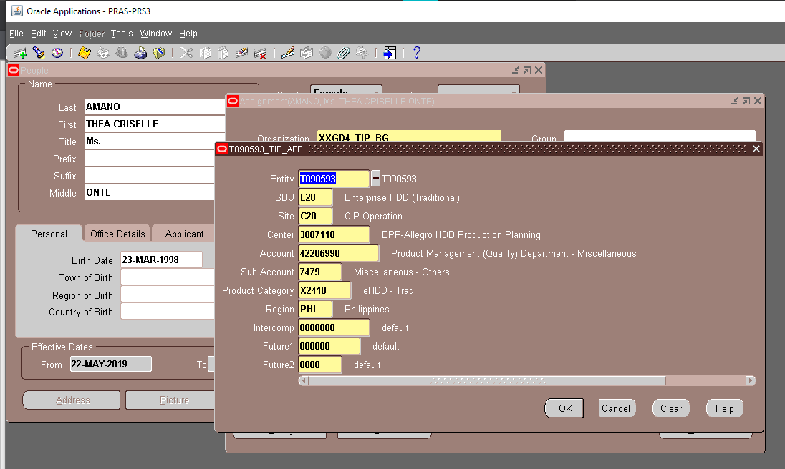
UPDATING THE COST CENTER
TIP ISD HELPDESK USER > ENTER AND MAINTAIN > ASSIGNMENTS> PURCHASE ORDER INFORMATION

Slide 24
END

